Slide 1
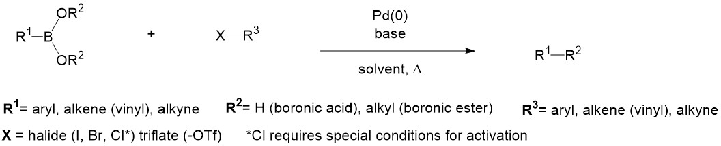
ML For Chemical Synthesis
Matthew O’Meara
BIOINF 595
3/11/2025
Notes:
Chemler, S. R.; Trauner, D.; Danishefsky, S. J. Angew. Chem. Int. Ed., 2001, 40 , 4544.
https://chem.libretexts.org/Bookshelves/Inorganic_Chemistry/Supplemental_Modules_and_Websites_(Inorganic_Chemistry)/Catalysis/Catalyst_Examples/Suzuki-Miyaura_Coupling

Slide 2
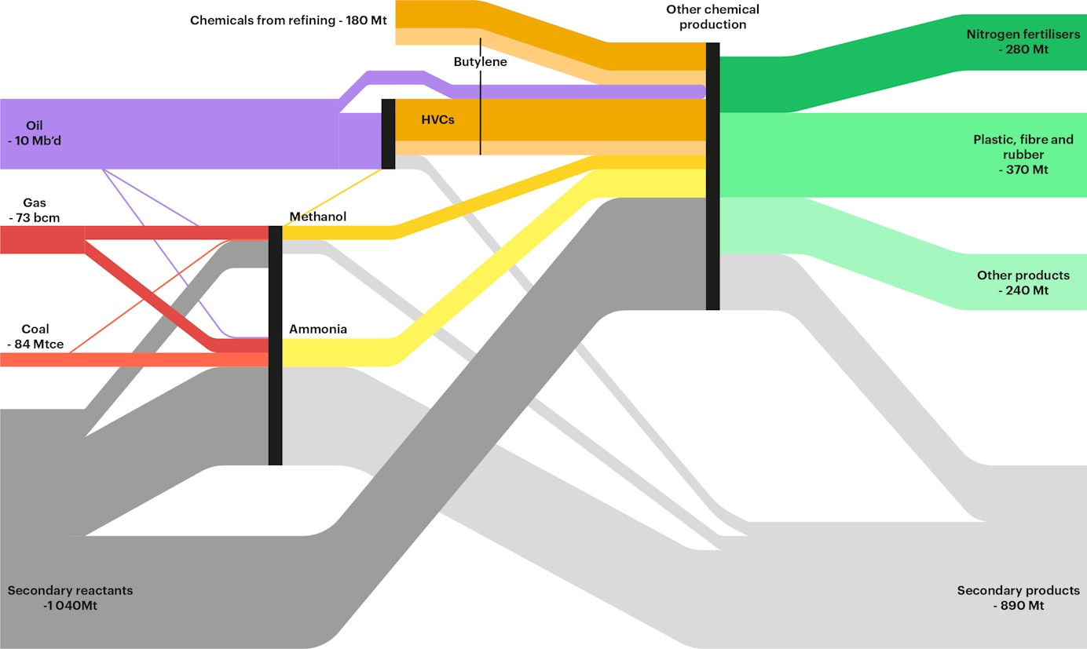
Energy cost of Chemistry Energy to chemical products, (2015)
iea.org/
International Energy Agency
Notes:
https://www.iea.org/commentaries/from-energy-to-chemicals

Slide 3
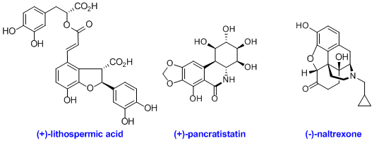
More Chemistry => diversity, lower cost of drugs?
Ellman C-H functionalization:

Slide 4
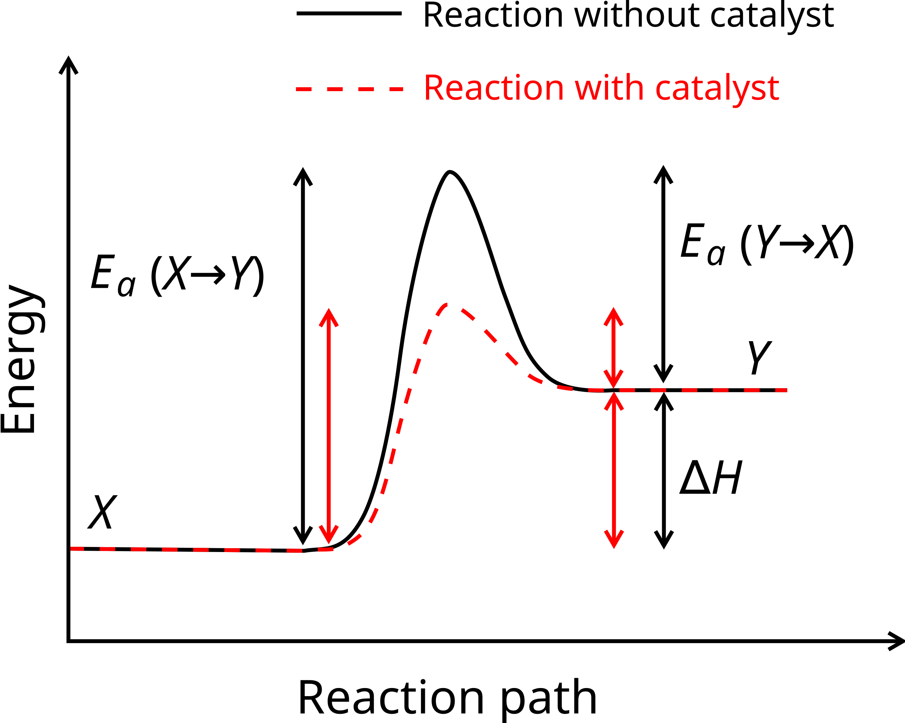
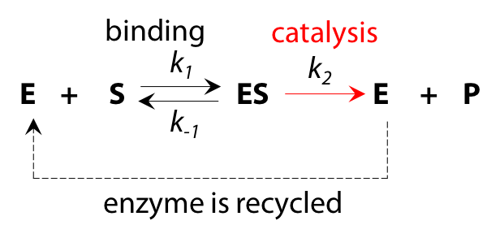
Reaction kinetics vs. equilibrium
Notes:
https://ecampusontario.pressbooks.pub/bioc2580/chapter/the-michaelis-menten-equation/

Slide 5
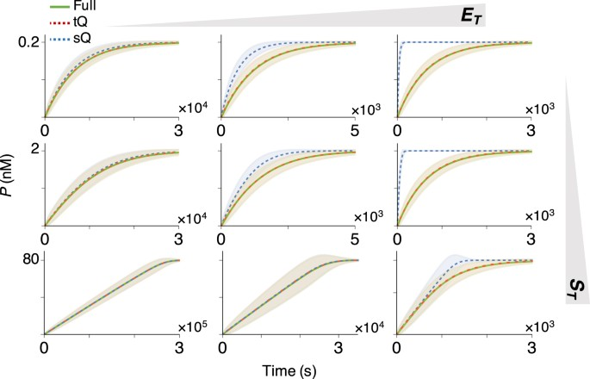
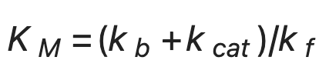
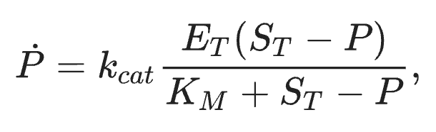
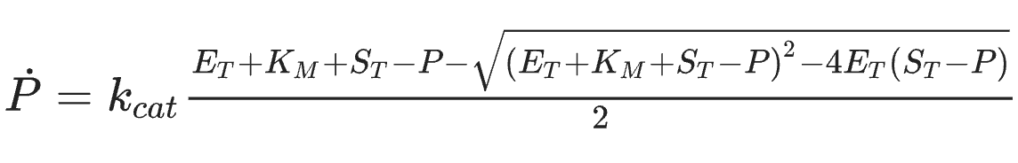
Progress Curve dynamics
Michaelis Menten (sQ):
Total quasi-steady-state approximation (tQ):

Slide 6
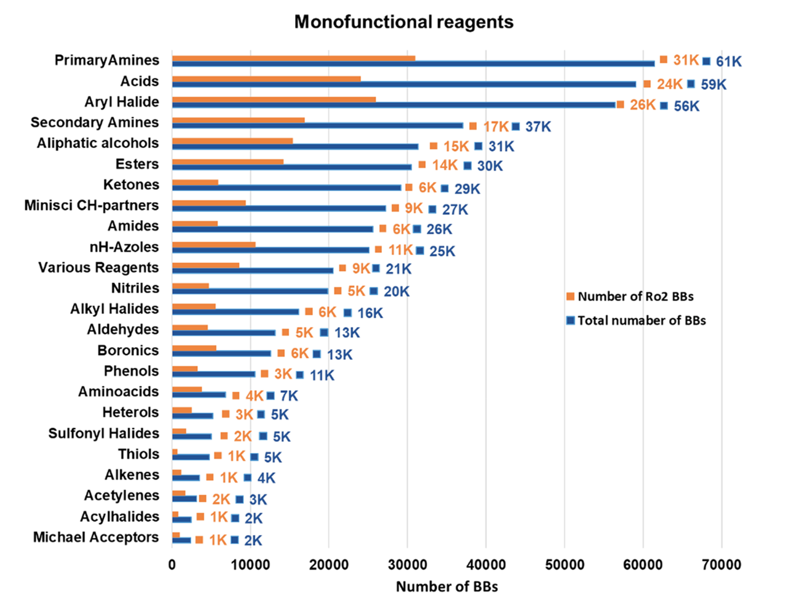
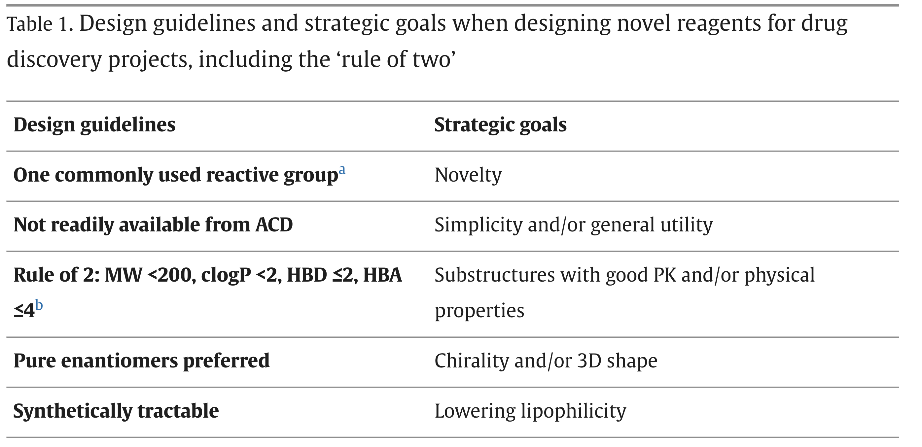
Diversity of Backbones in Pharma
Notes:
JCIM 2021, https://pubs.acs.org/doi/full/10.1021/acs.jcim.1c00811
A Close-up Look at the Chemical Space of Commercially Available Building Blocks for Medicinal Chemistry
https://www.sciencedirect.com/science/article/pii/S1359644614003894
Goldberg et al., DDT, 2015
Designing novel building blocks is an overlooked strategy to improve compound quality

Slide 7
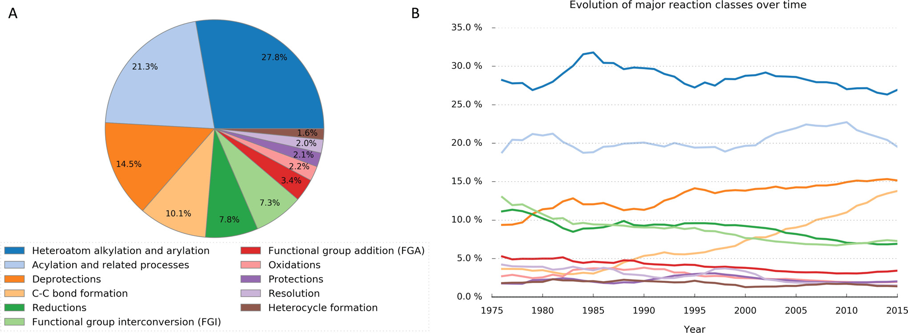
USPTO Data
(Schneider 2016)
Notes:
March 30, 2016
Big Data from Pharmaceutical Patents: A Computational Analysis of Medicinal Chemists’ Bread and Butter
Nadine Schneider*†
Daniel M. Lowe§
Roger A. Sayle§
Michael A. Tarselli‡
Gregory A. Landrum†

Slide 8
USPTO Data
(Schneider 2016)
Notes:
March 30, 2016
Big Data from Pharmaceutical Patents: A Computational Analysis of Medicinal Chemists’ Bread and Butter
Nadine Schneider*†
Daniel M. Lowe§
Roger A. Sayle§
Michael A. Tarselli‡
Gregory A. Landrum†

Slide 9
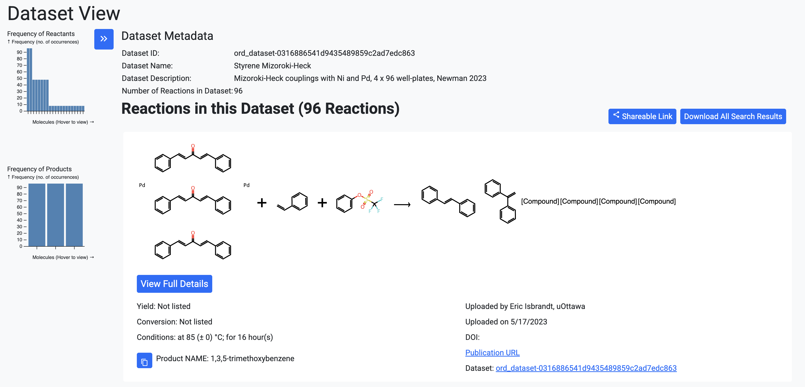
Open Reaction Database

Slide 10
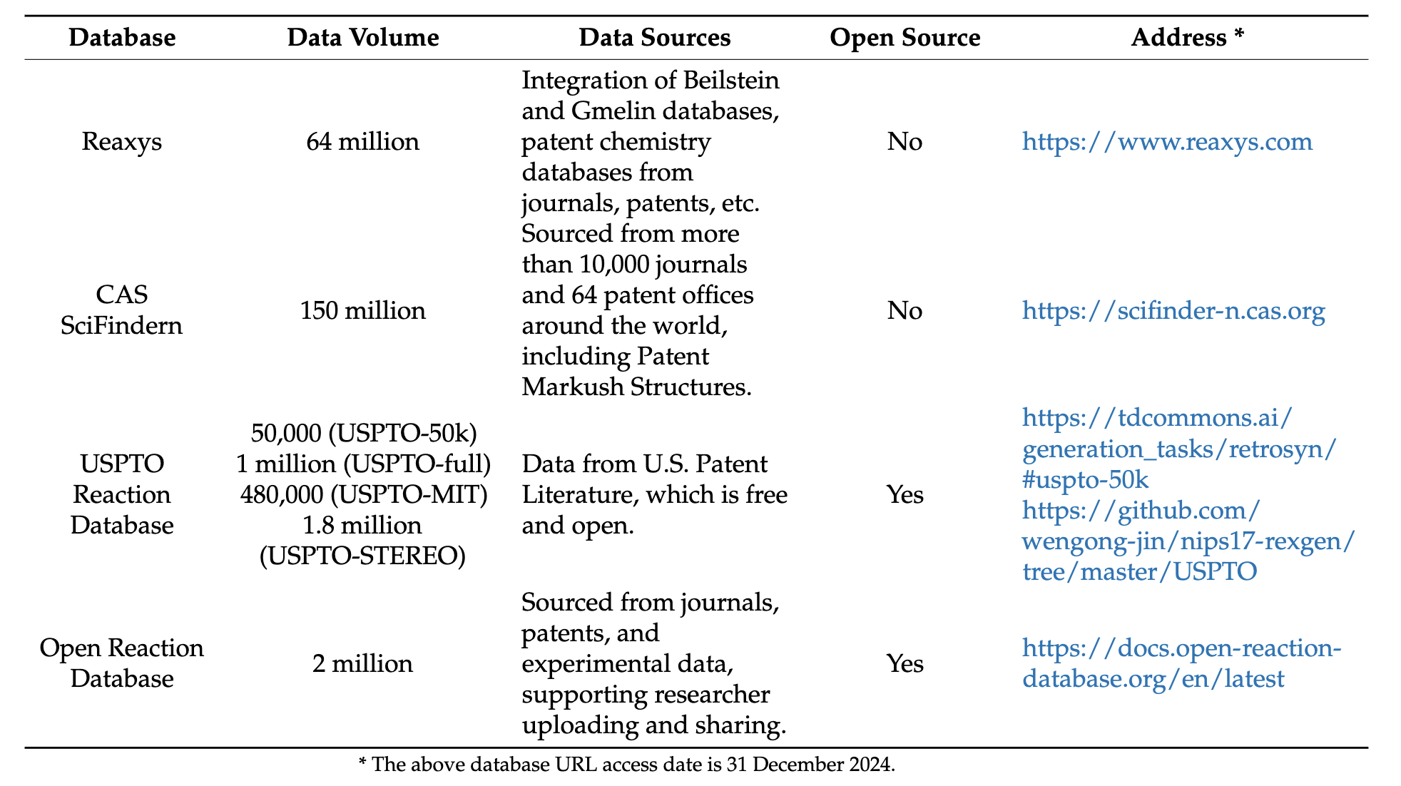
Current state of reaction literature reaction data

Slide 11
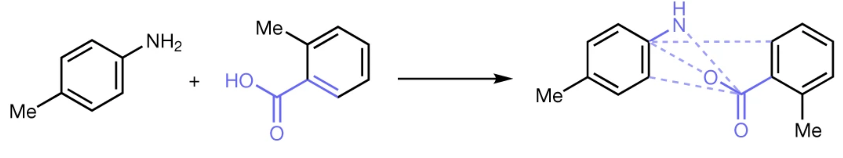
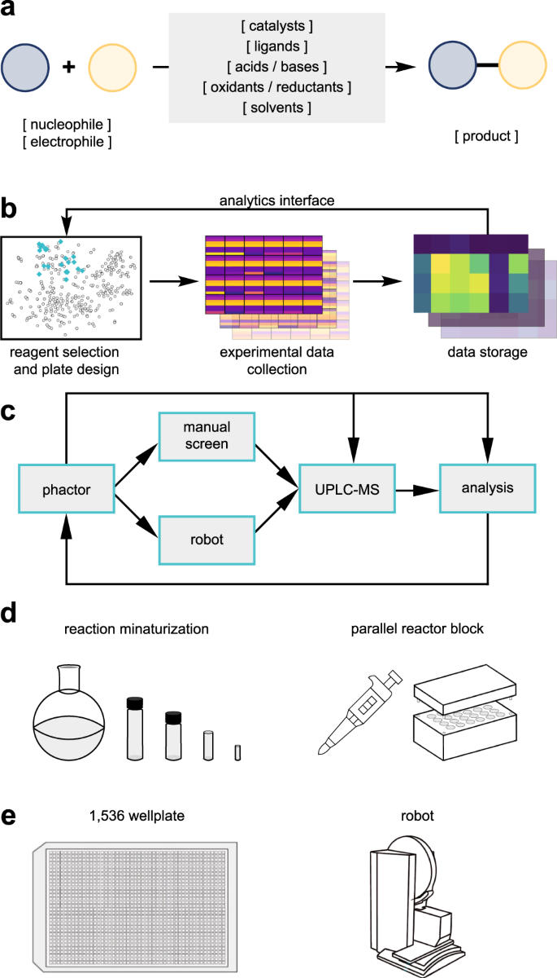
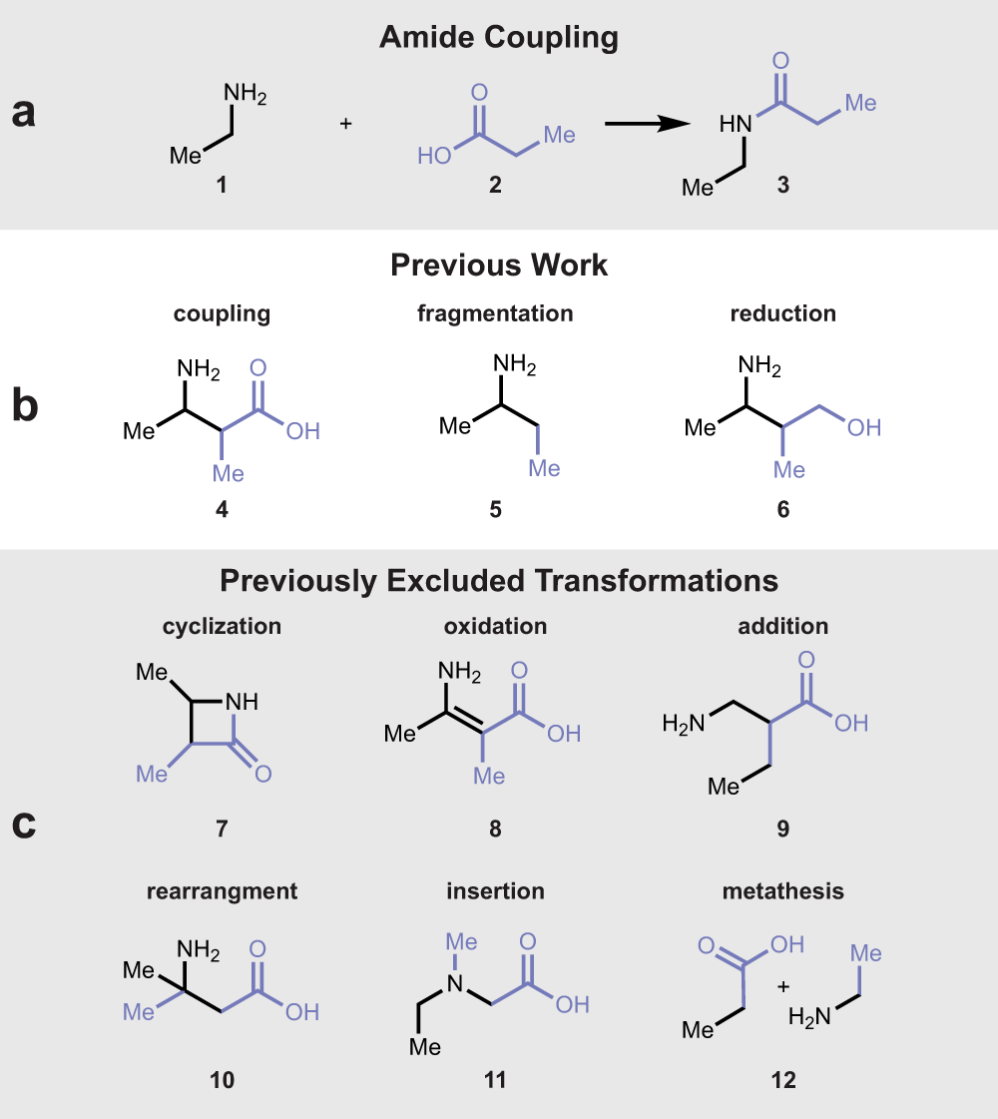
High throughput experimentation (Amide coupling)
(Cernak Lab)
Notes:
Exploring the combinatorial explosion of amine–acid reaction space via graph editing
Rui Zhang,
Babak Mahjour,
Andrew Outlaw,
Andrew McGrath,
Tim Hopper,
Brian Kelley,
W. Patrick Walters &
Tim Cernak
Communications Chemistry volume 7, Article number: 22 (2024)

Slide 12
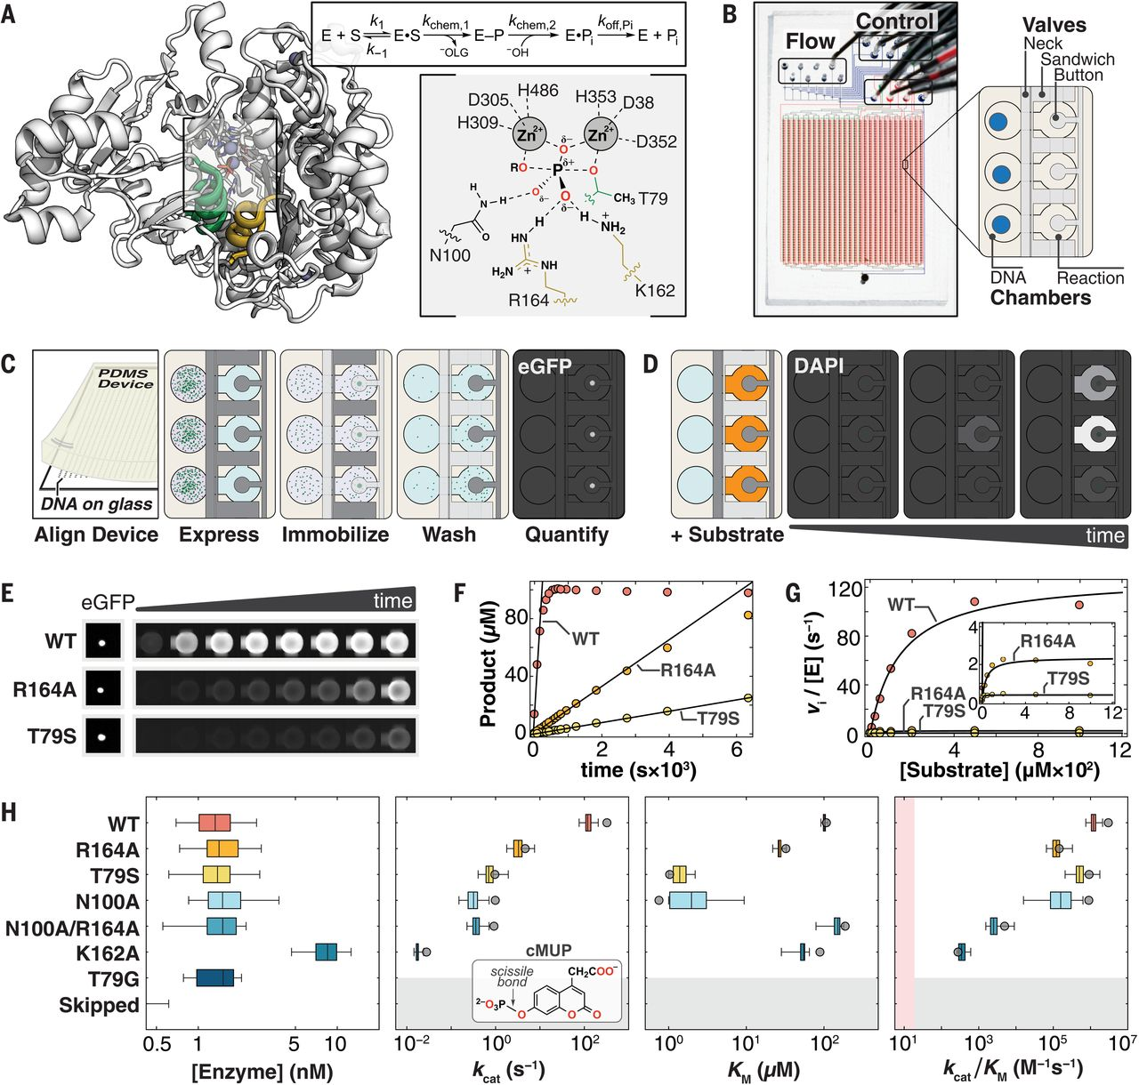
High-throughput experimentation (Enzymology)
(Markin, 2021)
Notes:
Revealing enzyme functional architecture via high-throughput microfluidic enzyme kinetics
C. J. Markin https://orcid.org/0000-0002-2147-0744, D. A. Mokhtari https://orcid.org/0000-0003-4206-9471, F. Sunden https://orcid.org/0000-0003-4110-7384, M. J. Appel https://orcid.org/0000-0001-7501-8115, E. Akiva, S. A. Longwell https://orcid.org/0000-0003-4064-0400, C. Sabatti https://orcid.org/0000-0001-5829-9058, D. Herschlag https://orcid.org/0000-0002-4685-1973 , and P. M. Fordyce https://orcid.org/0000-0002-9505-0638
https://www.science.org/doi/full/10.1126/science.abf8761

Slide 13
High-throughput experimentation (Enzymology)
(Markin, 2021)
Notes:
Revealing enzyme functional architecture via high-throughput microfluidic enzyme kinetics
C. J. Markin https://orcid.org/0000-0002-2147-0744, D. A. Mokhtari https://orcid.org/0000-0003-4206-9471, F. Sunden https://orcid.org/0000-0003-4110-7384, M. J. Appel https://orcid.org/0000-0001-7501-8115, E. Akiva, S. A. Longwell https://orcid.org/0000-0003-4064-0400, C. Sabatti https://orcid.org/0000-0001-5829-9058, D. Herschlag https://orcid.org/0000-0002-4685-1973 , and P. M. Fordyce https://orcid.org/0000-0002-9505-0638
https://www.science.org/doi/full/10.1126/science.abf8761

Slide 14
High-throughput experimentation (Enzymology)
(Markin, 2021)
Notes:
Revealing enzyme functional architecture via high-throughput microfluidic enzyme kinetics
C. J. Markin https://orcid.org/0000-0002-2147-0744, D. A. Mokhtari https://orcid.org/0000-0003-4206-9471, F. Sunden https://orcid.org/0000-0003-4110-7384, M. J. Appel https://orcid.org/0000-0001-7501-8115, E. Akiva, S. A. Longwell https://orcid.org/0000-0003-4064-0400, C. Sabatti https://orcid.org/0000-0001-5829-9058, D. Herschlag https://orcid.org/0000-0002-4685-1973 , and P. M. Fordyce https://orcid.org/0000-0002-9505-0638
https://www.science.org/doi/full/10.1126/science.abf8761

Slide 15
High-throughput experimentation (Enzymology)
(Markin, 2021)
Notes:
Revealing enzyme functional architecture via high-throughput microfluidic enzyme kinetics
C. J. Markin https://orcid.org/0000-0002-2147-0744, D. A. Mokhtari https://orcid.org/0000-0003-4206-9471, F. Sunden https://orcid.org/0000-0003-4110-7384, M. J. Appel https://orcid.org/0000-0001-7501-8115, E. Akiva, S. A. Longwell https://orcid.org/0000-0003-4064-0400, C. Sabatti https://orcid.org/0000-0001-5829-9058, D. Herschlag https://orcid.org/0000-0002-4685-1973 , and P. M. Fordyce https://orcid.org/0000-0002-9505-0638
https://www.science.org/doi/full/10.1126/science.abf8761

Slide 16
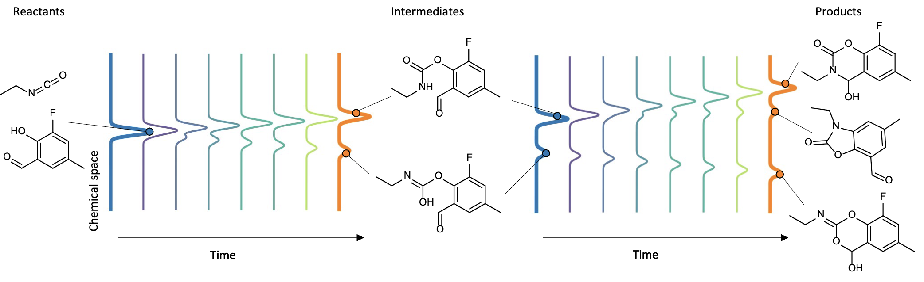
Reaction prediction
Given
Substrate
Co-factors
Conditions
Predict
Distribution of products

Slide 17
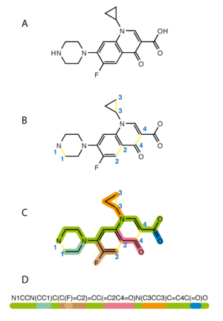
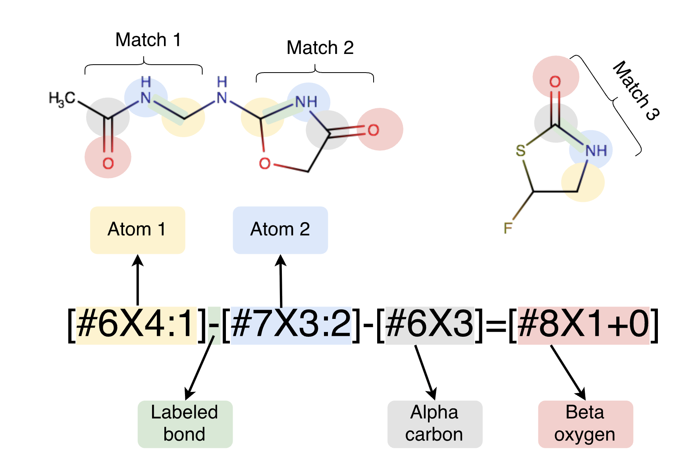
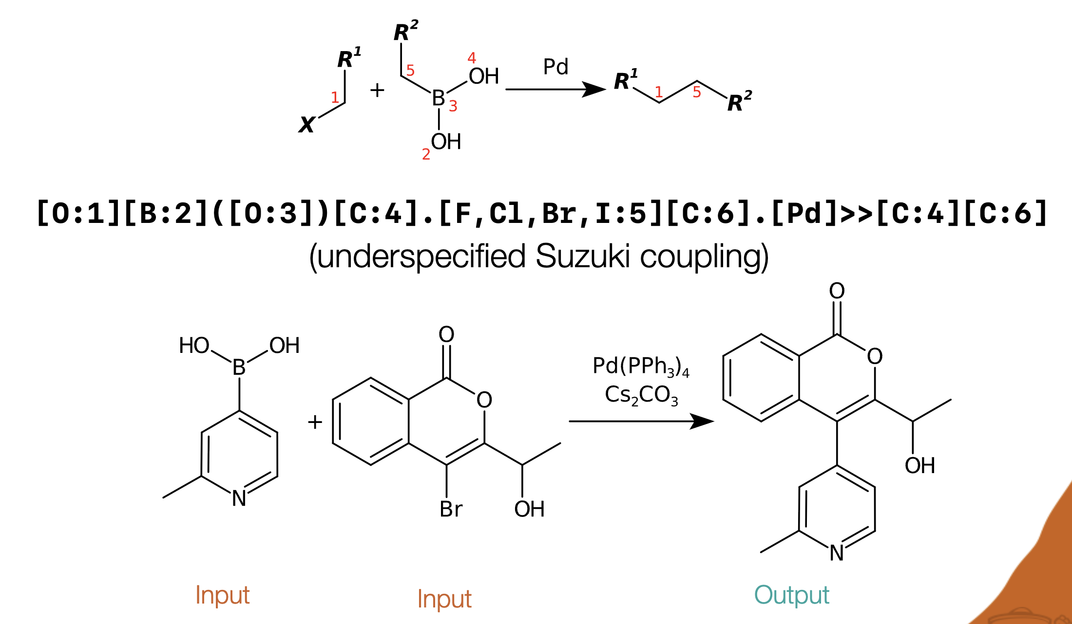
SMILES
SMARTS
SMIRKS
SMILES arbitrary target specification
Notes:
https://www.biorxiv.org/content/10.1101/286542v3
https://www.nextmovesoftware.com/talks/Mayfield_SmirksQuirks_AcsFall_2023.pdf#page=6.00

Slide 18
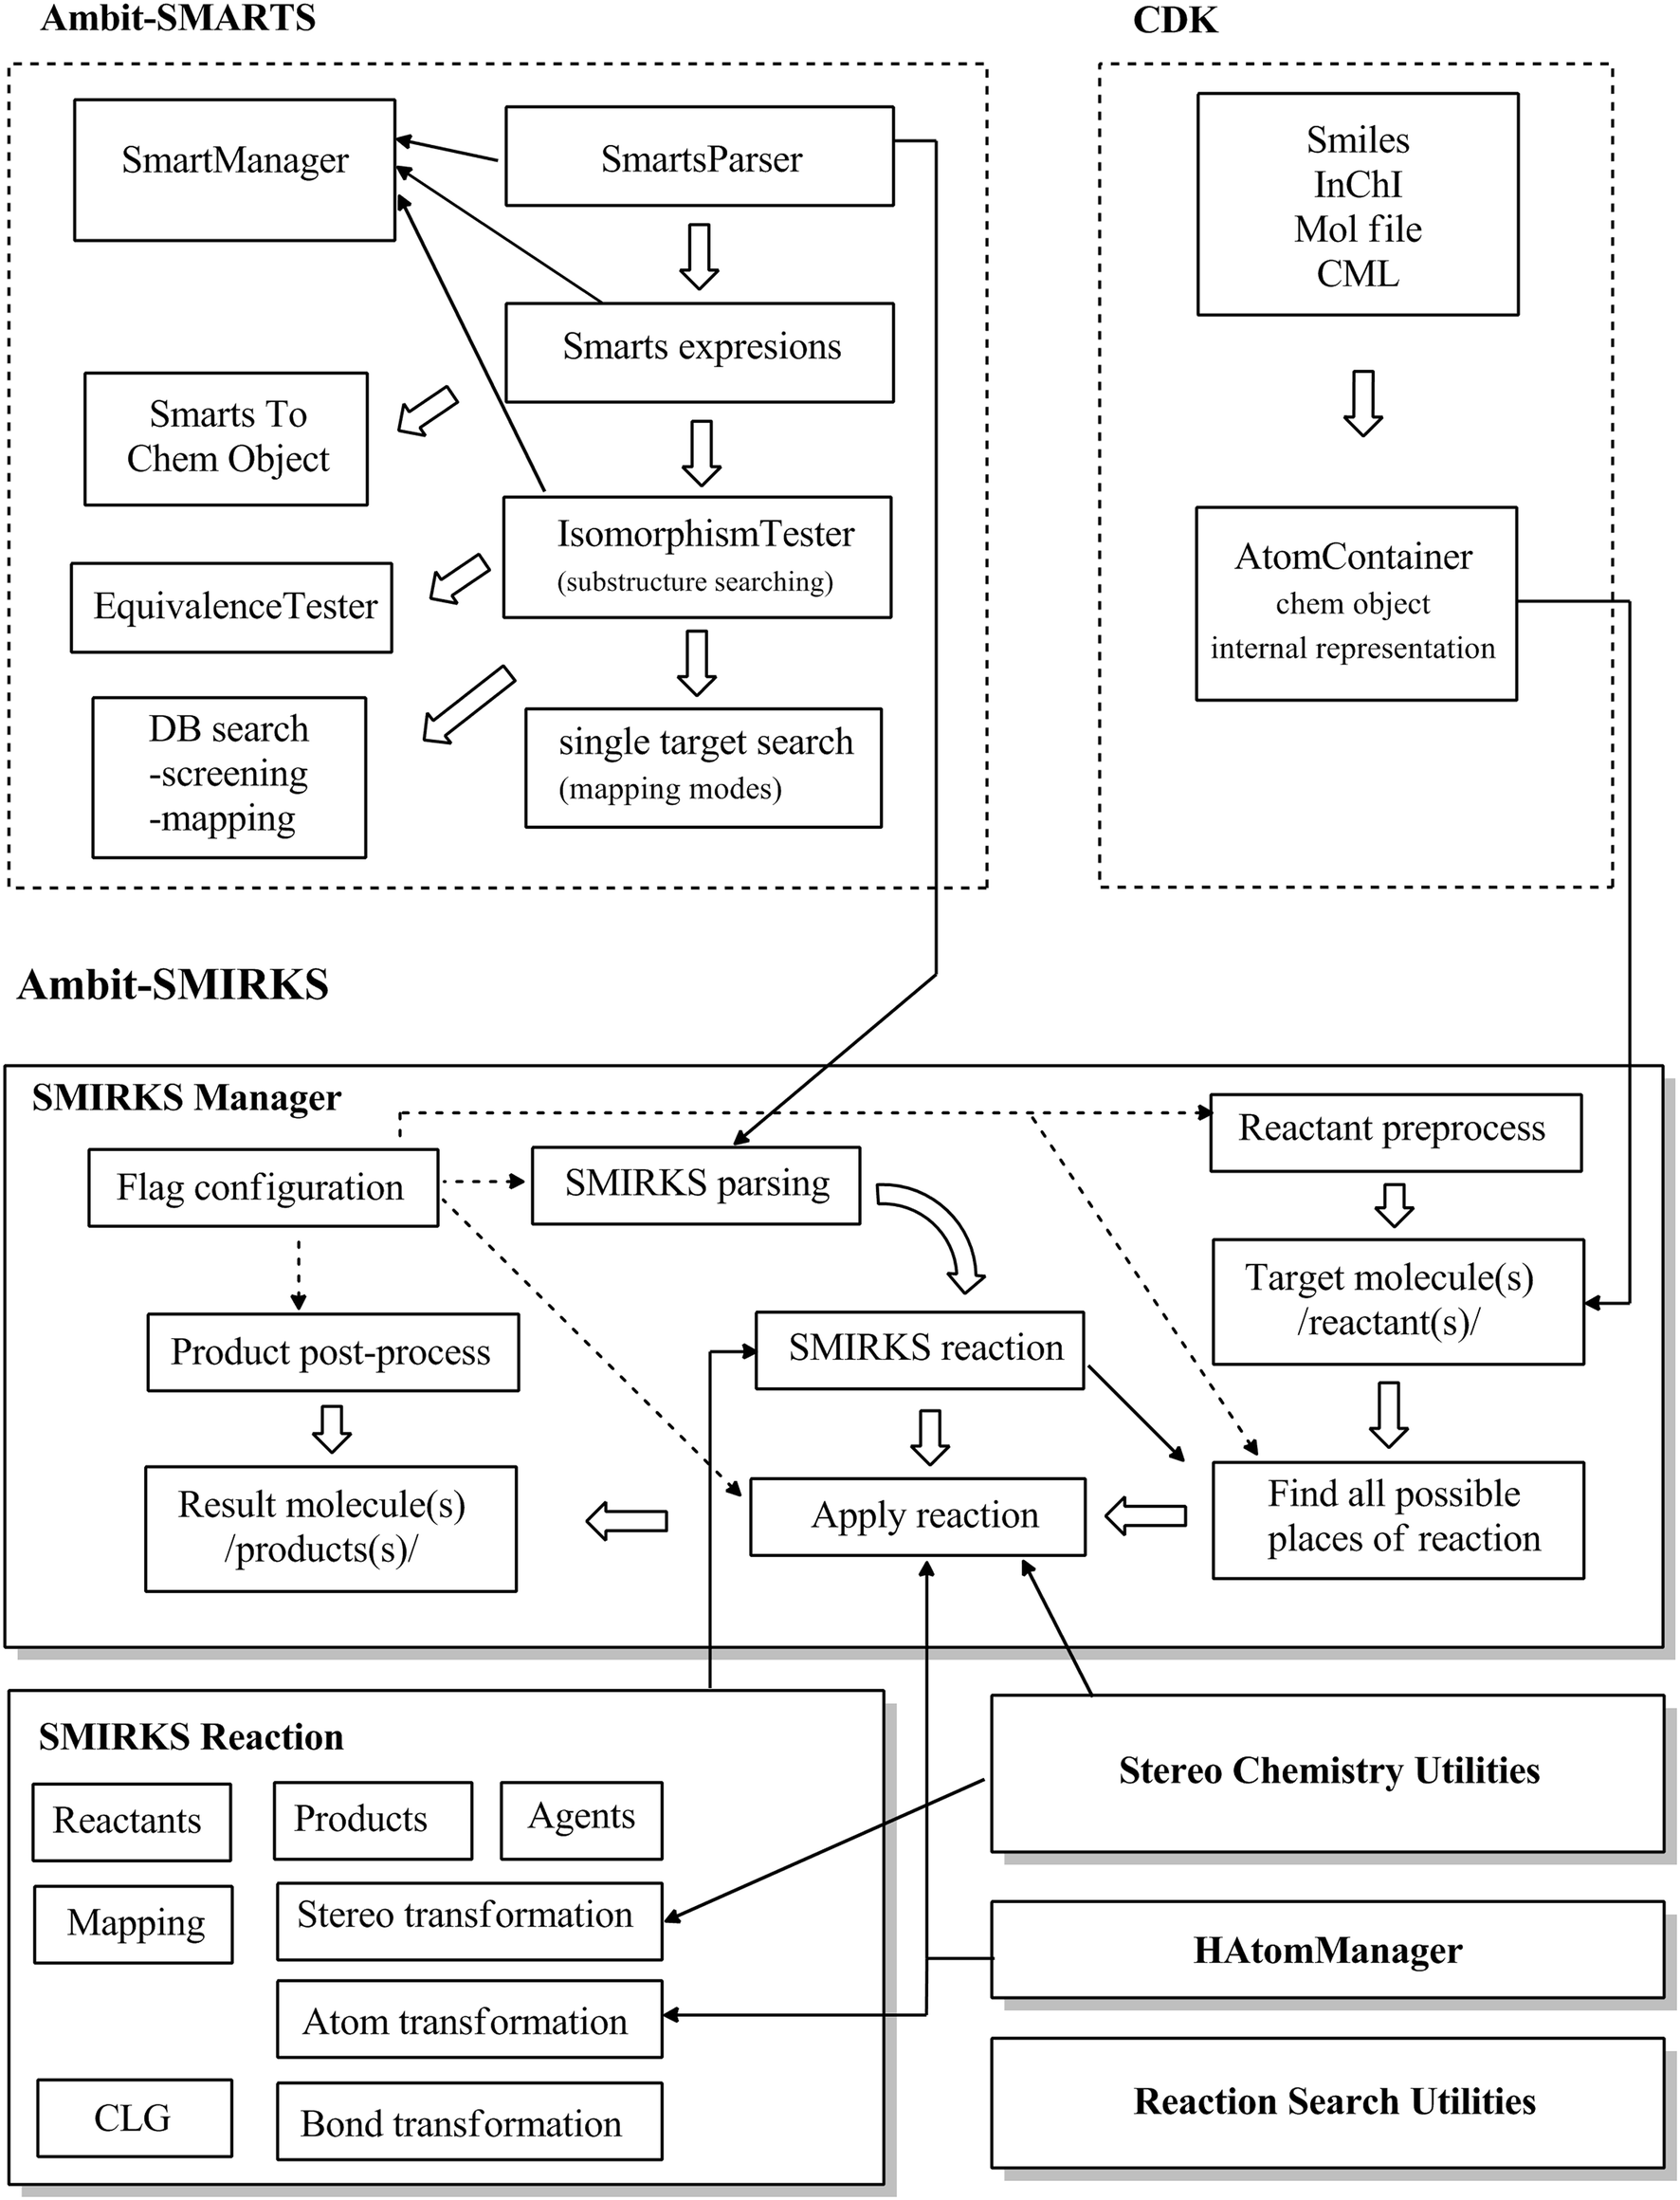
Complexity of high-quality reaction parsers
Notes:
Ambit-SMIRKS: a software module for reaction representation, reaction search and structure transformation
Nikolay Kochev,
Svetlana Avramova &
Nina Jeliazkova
Journal of Cheminformatics volume 10, Article number: 42 (2018)

Slide 19
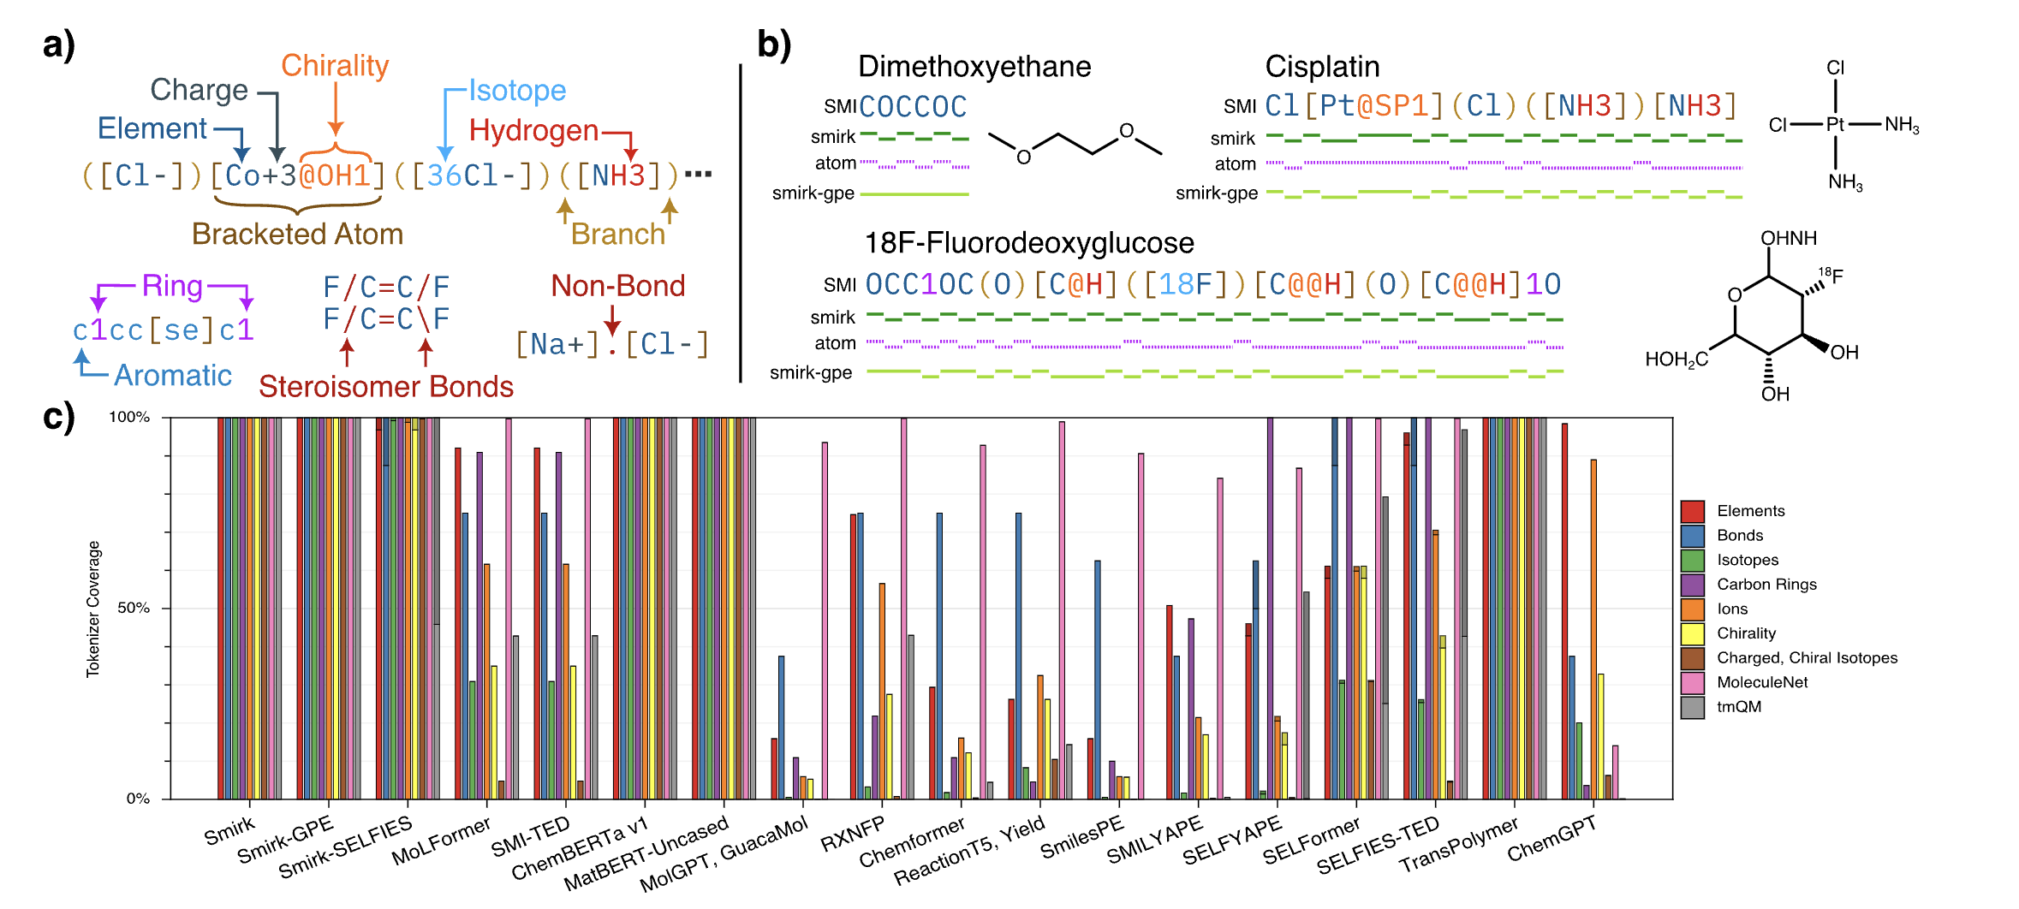
Chemistry Tokenizers (Coverage)
Notes:
Smirk: An Atomically Complete Tokenizer for
Molecular Foundation Models
Alexius Wadell,†,‡ Anoushka Bhutani,†,‡ and Venkatasubramanian
Viswanathan∗,†,‡
https://arxiv.org/abs/2409.15370
2025

Slide 20
Chemistry Tokenizers (Coverage)
Notes:
Smirk: An Atomically Complete Tokenizer for
Molecular Foundation Models
Alexius Wadell,†,‡ Anoushka Bhutani,†,‡ and Venkatasubramanian
Viswanathan∗,†,‡
https://arxiv.org/abs/2409.15370
2025

Slide 21
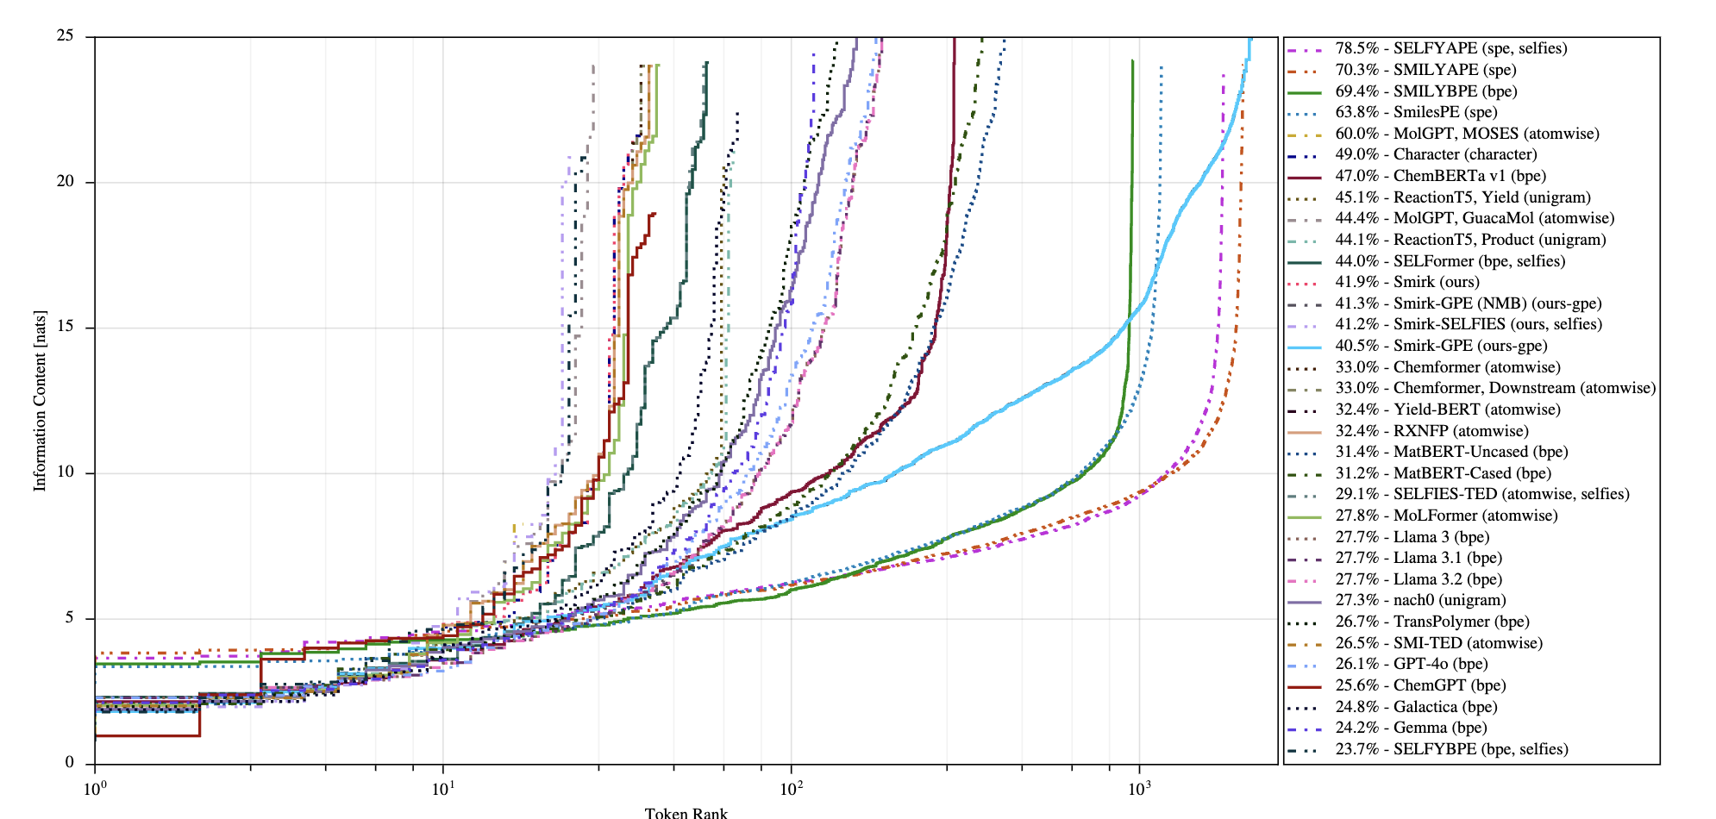
Chemistry Tokenizers (Information Density)

Slide 22
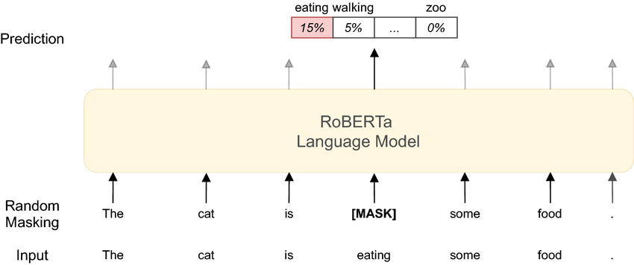
BERT-style masked language model

Slide 23
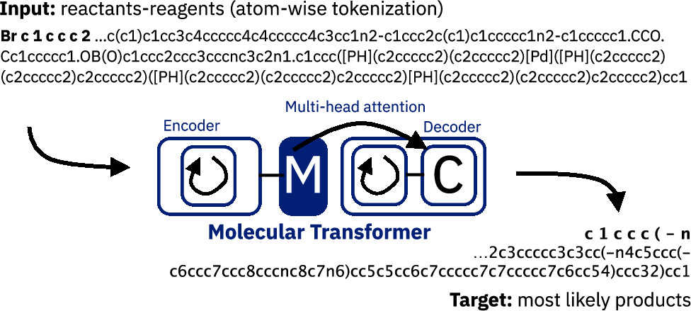
Transformer for chemistry reaction prediction
Notes:
August 30, 2019
Molecular Transformer: A Model for Uncertainty-Calibrated Chemical Reaction Prediction
Philippe Schwaller*
Teodoro Laino
Théophile Gaudin
Peter Bolgar
Christopher A. Hunter
Costas Bekas
Alpha A. Lee*
https://pubs.acs.org/doi/full/10.1021/acscentsci.9b00576

Slide 24
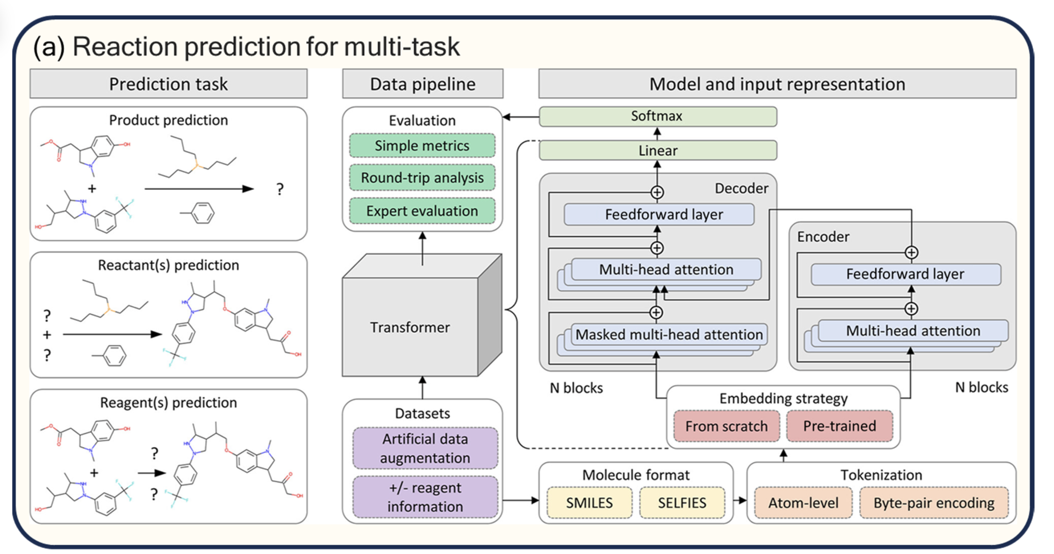
Integrated reaction prediction models
Notes:
Application of Transformers to Chemical Synthesis
Dong Jin 1, Yuli Liang 1, Zihao Xiong 1, Xiaojie Yang 2, Haifeng Wang 1, Jie Zeng 1,* and Shuangxi Gu 1,*
https://www.mdpi.com/1420-3049/30/3/493

Slide 25
Integrated reaction prediction models
Notes:
Application of Transformers to Chemical Synthesis
Dong Jin 1, Yuli Liang 1, Zihao Xiong 1, Xiaojie Yang 2, Haifeng Wang 1, Jie Zeng 1,* and Shuangxi Gu 1,*
https://www.mdpi.com/1420-3049/30/3/493

Slide 26
Integrated reaction prediction models
Notes:
Application of Transformers to Chemical Synthesis
Dong Jin 1, Yuli Liang 1, Zihao Xiong 1, Xiaojie Yang 2, Haifeng Wang 1, Jie Zeng 1,* and Shuangxi Gu 1,*
https://www.mdpi.com/1420-3049/30/3/493

Slide 27
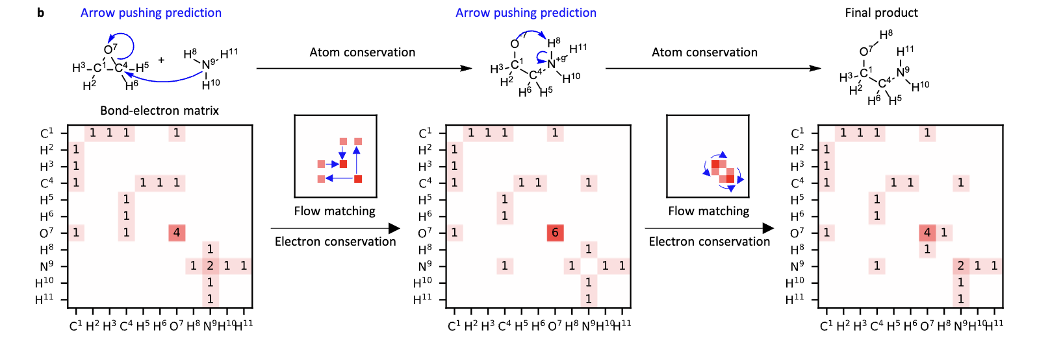
Electron Flow Matching Invariance: conservation of charge
Electron flow matching for generative reaction mechanism prediction obeying conservation laws
Joonyoung F. Joung, Mun Hong Fong, Nicholas Casetti, Jordan P. Liles, Ne S. Dassanayake, Connor W. Coley
Notes:
https://arxiv.org/abs/2502.12979

Slide 28
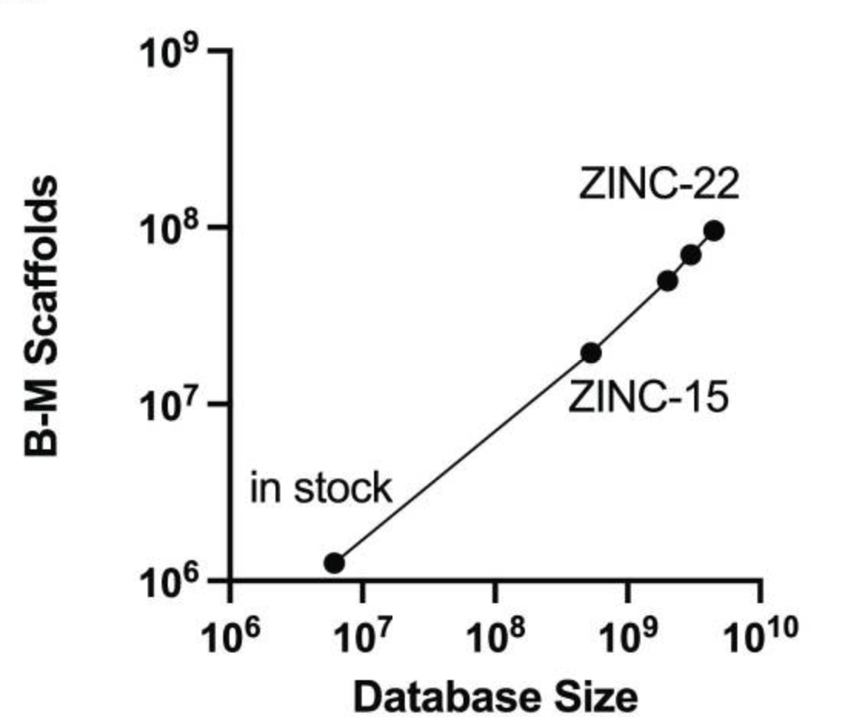
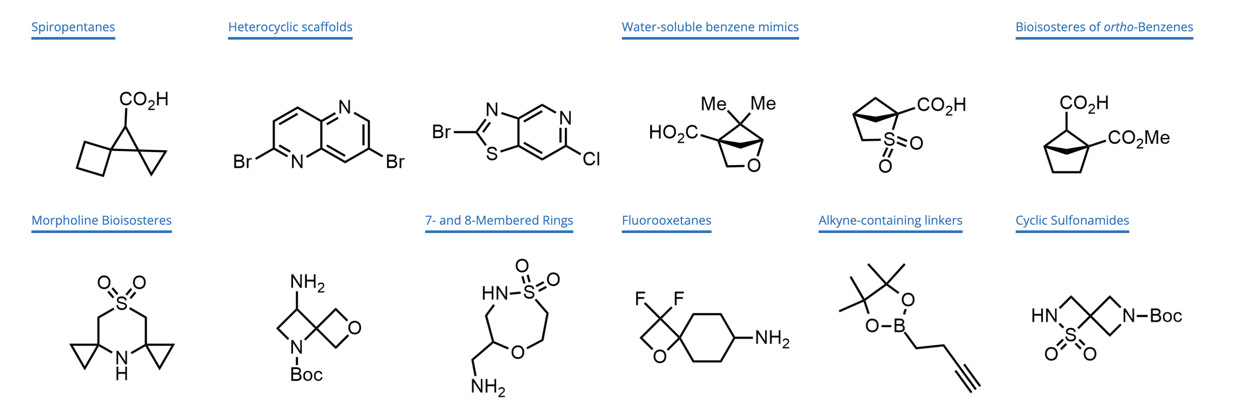
Make on Demand Libraries
REAL Space by Enamine
AMBrosia by Ambinter
CHEMriya by OTAVAchemicals
eXplore by eMolecules
Freedom Space by Chemspace
GalaXi by WuXi LabNetwork
In-stock building block collections
Diversity of chemical reactions
Price / time / quality
Enamine is developing ~2,000 new building blocks a month:

Slide 29
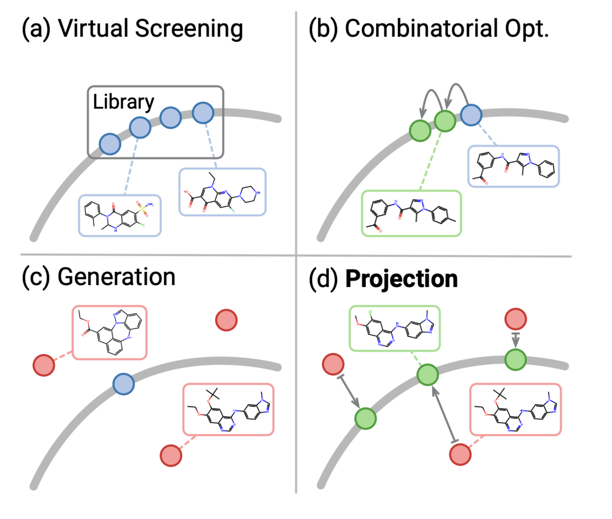
Virtual screening
(Luo, et al., 2024)
Notes:
Projecting Molecules into Synthesizable Chemical Spaces
Shitong Luo, Wenhao Gao, Zuofan Wu, Jian Peng, Connor W. Coley, Jianzhu Ma
https://arxiv.org/abs/2406.04628

Slide 30
Analog by Catalog
(Luo, et al., 2024)
Notes:
Projecting Molecules into Synthesizable Chemical Spaces
Shitong Luo, Wenhao Gao, Zuofan Wu, Jian Peng, Connor W. Coley, Jianzhu Ma
https://arxiv.org/abs/2406.04628

Slide 31
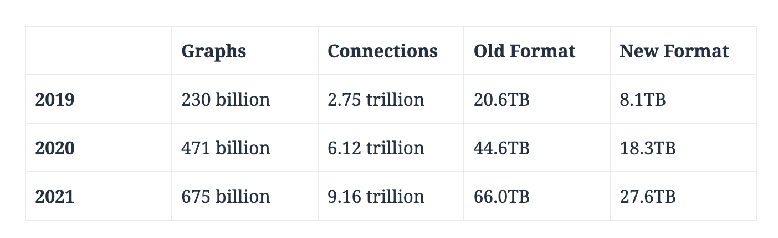
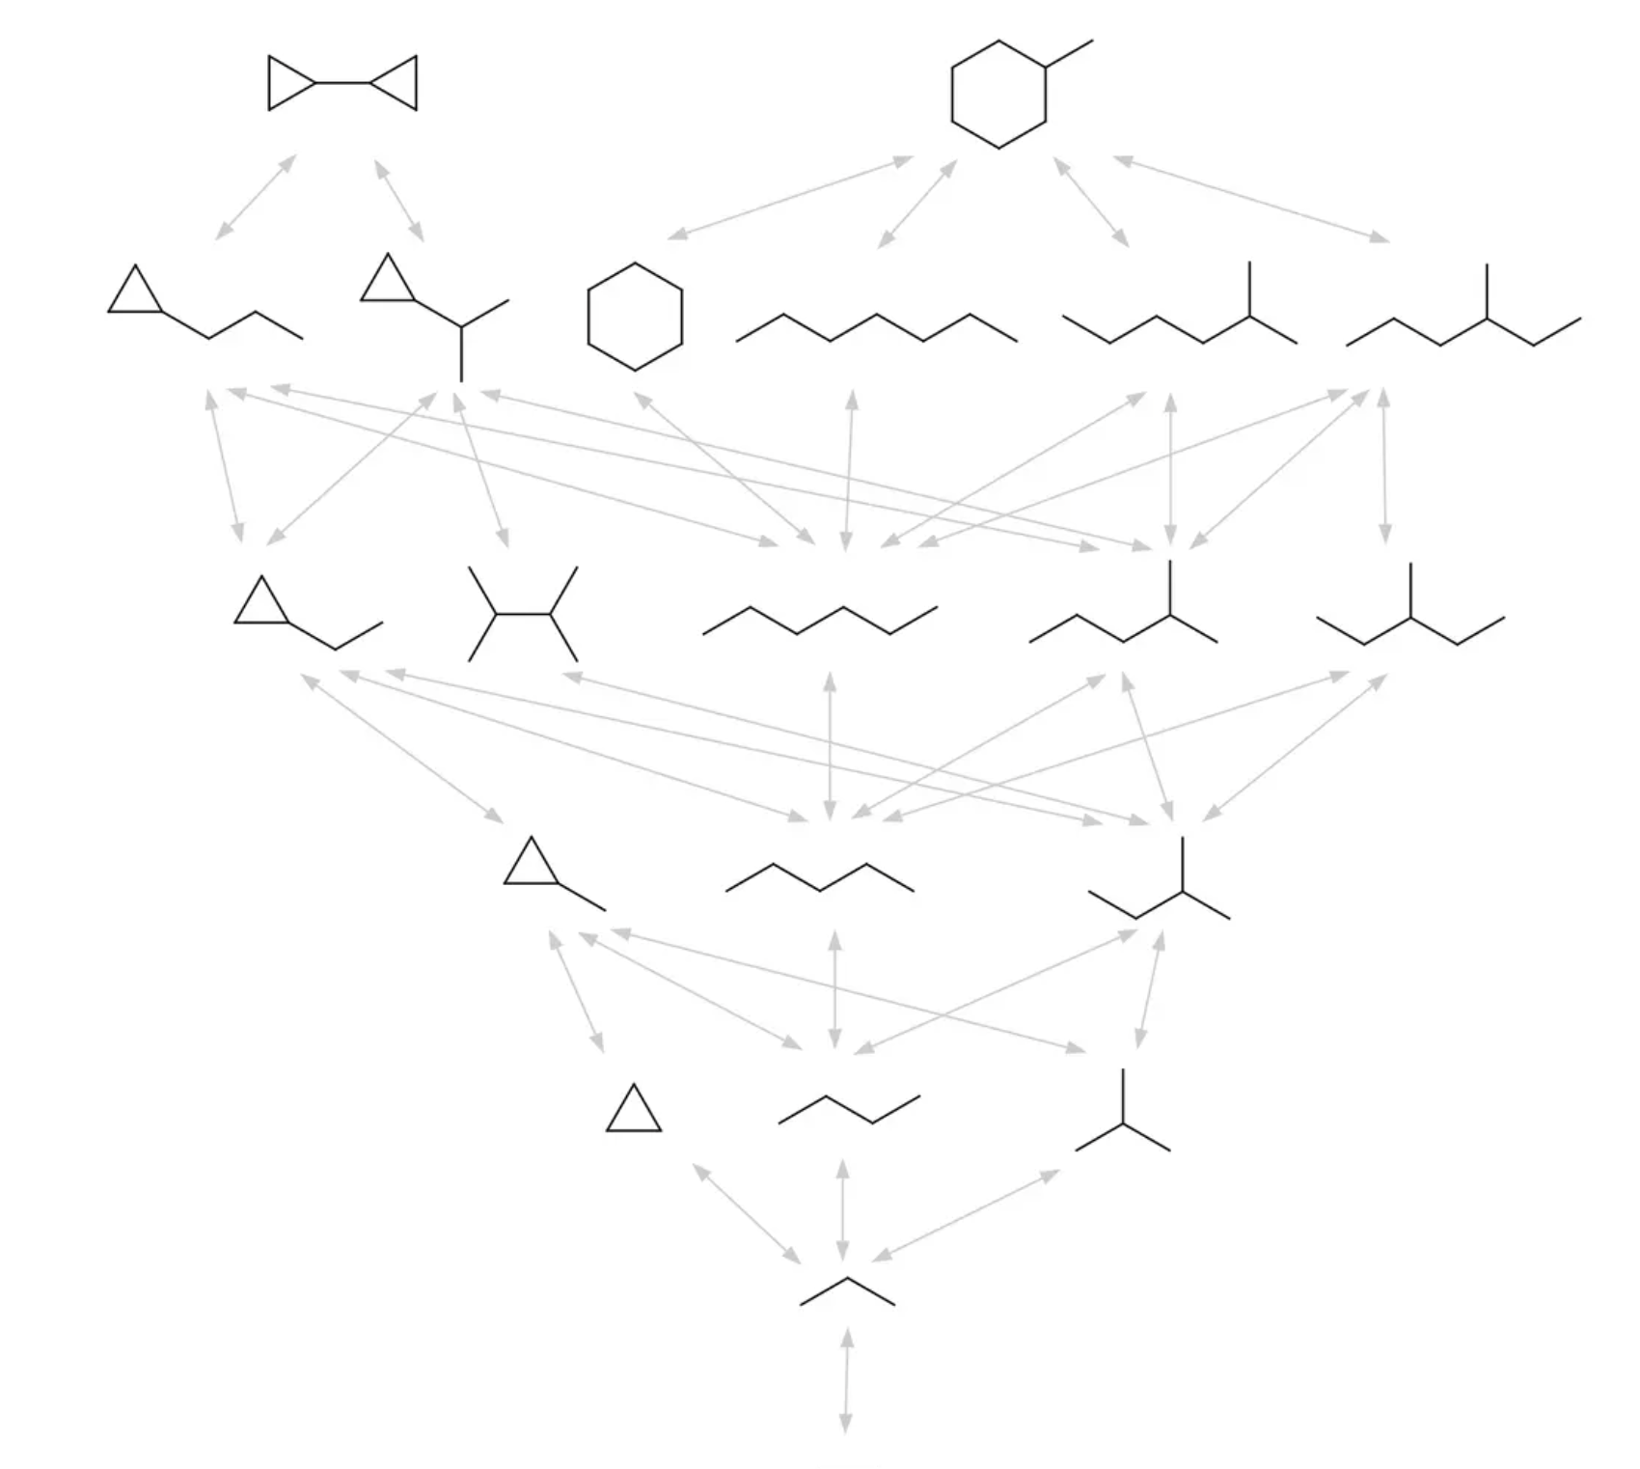
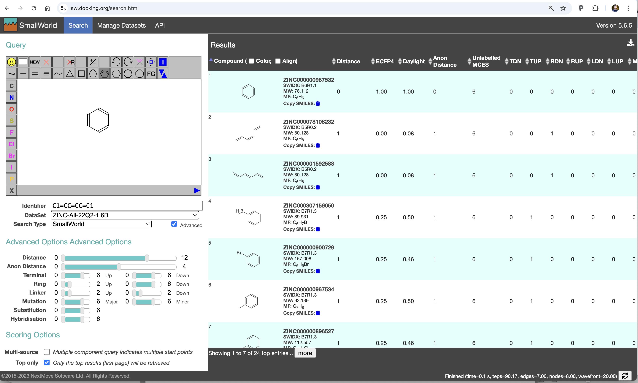
Small World
Hierarchical graph-edit representation

Slide 32
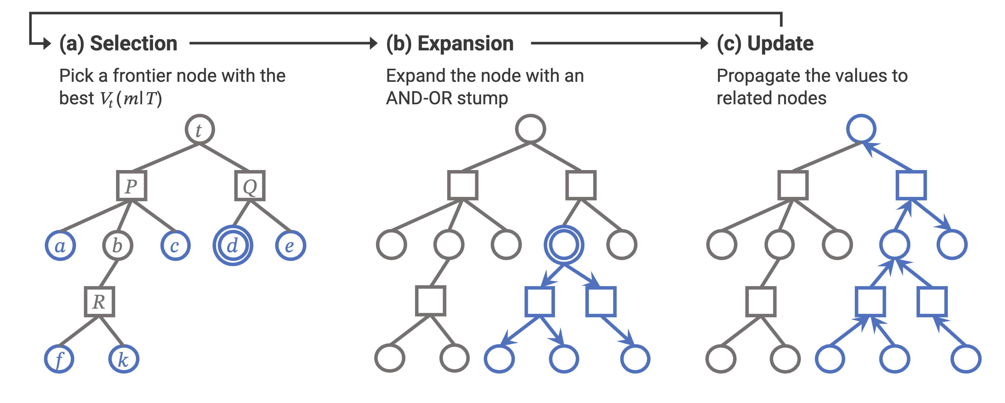
Retrosynthesis
Given a molecules what is the best route for synthesizing it?
Reaction prediction
Availability of building blocks
Cost / efficiency of reaction
Notes:
http://binghongchen.net/projects/retro_star.html

Slide 33



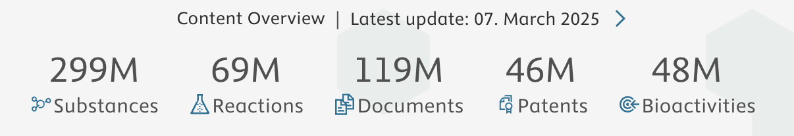
Synthesis Planners
https://askcos.mit.edu/
https://app.postera.ai/
https://www.reaxys.com/

